Slide 1
UNIT – II
Optimization

Slide 2
Optimizer algorithms are optimization method that helps to improve a deep learning model’s performance.
Optimization algorithms or optimizers widely affect the accuracy and speed training of the deep learning model
While training the deep learning optimizers model, modify each epoch’s weights and learning rates to minimize the loss function. it helps in reducing the overall loss and improving accuracy.
Optimization for training deep neural networks
Finding the parameters 𝜃 of a neural network that significantly reduce a cost function 𝐽(𝜃)
This cost function is an empirical risk function defined only over training data
At the same time, hoping that cost is minimum on the test data also which so far unseen by the model
This means generalization error should also be reduced

Slide 3
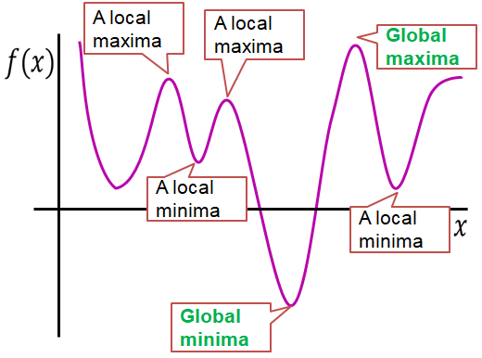

Slide 4
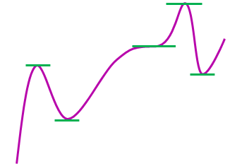
𝑓’(𝑥)= 0 at 𝑥
𝑓’(𝑥)= 0 just before 𝑥 𝑓’(𝑥)= 0 just after 𝑥
𝑥 may be a saddle
𝑓’(𝑥)= 0 at 𝑥,
𝑓’(𝑥)>0 just before 𝑥
𝑓’(𝑥)<0 just after 𝑥
𝑥 is a maxima
𝑓’(𝑥)= 0 at 𝑥
𝑓’(𝑥)< 0 just before 𝑥 𝑓’(𝑥)>0 just after 𝑥
𝑥 is a minima

Slide 5
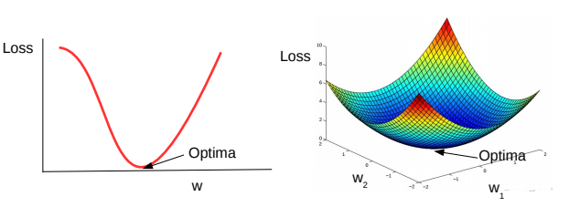
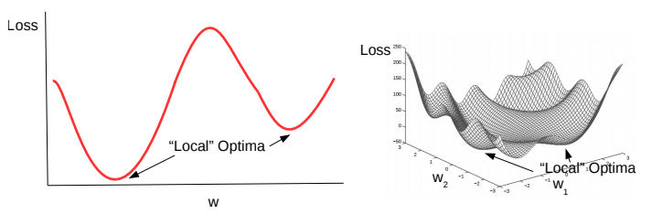
Convex and Non-Convex Functions
A function being optimized can be either convex or non-convex.
Convex functions are bowl-shaped. They have a unique optima (minima)
Negative of a convex function is called a concave function, which also has a unique optima (maxima)
Non-convex functions have multiple minima. Usually harder to optimize as compared to convex functions
Loss functions of most deep learning models are non-convex

Slide 6
What is neural network training?
Finding the parameters 𝜃 of a neural network that significantly reduce a cost function 𝐽(𝜃)
What that cost functions consists of?
Cost function typically includes
A performance measure evaluated on the entire training set
As well as additional regularization terms.
How this training of neural networks is accomplished?
Most of the learning/training algorithms are based on Gradient Descent (GD)
GD updates the parameters in a directions opposite to the gradient of the cost functions at the current parameter value.
What is optimization in neural network training?
Finding the parameters 𝜃 as quickly as possible
How the Optimization algorithms speeds up the training process?
Adapt their learning rates during training
Leverage information contained in the second derivatives of the cost function.

Slide 7
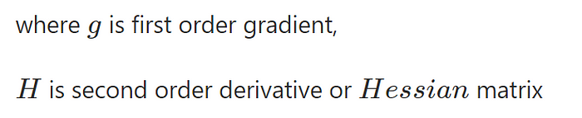
Challenges in neural network optimization
1. Ill-conditioning
Ill-conditioning can manifest by causing SGD to get “stuck” in the sense that even very small steps increase the cost function.
From the literature, ill-conditioning occurs when second order term of Taylor series expansion is greater than the first order term.
In many cases, the gradient norm does not shrink significantly throughout learning, but the g^{T}Hg term grows by more than an order of magnitude. The result is that learning becomes very slow despite the presence of a strong gradient because the learning rate must be shrunk to compensate for even stronger curvature.

Slide 8
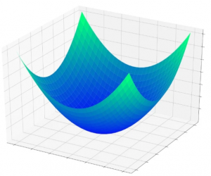
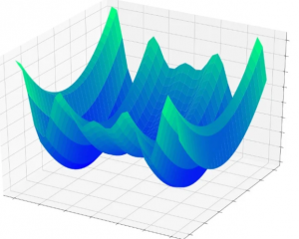
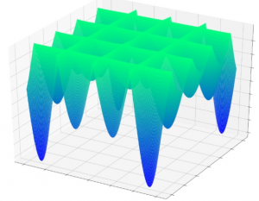
2. Local minima
Gradient descent relies on local information that will lead a network toward the global minimum. The network has no prior knowledge about the characteristics of the overall error surface, and consequently when it reaches a point that seems like the bottom of the error surface based on local information, it cannot pull out a topographical map and determine that it needs to go back uphill in order to find the point that is actually lower than all others.
One way to overcome a local minimum problem in neural networks is to use techniques such as stochastic gradient descent with momentum, which can help the algorithm escape from local minima.
Another approach is to use more complex optimization algorithms, such as Adam or Adagrad.
Additionally, increasing the complexity of the neural network or adjusting the learning rate can also help to avoid getting stuck in local minima.

Slide 9
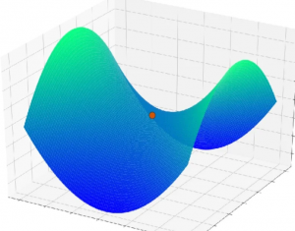
3. Saddle Points
Saddle points are the flat region in the error surface, which makes the gradient value nearly zero. This hinders the learning rate because the direction towards minima becomes uncertain.
with the increased dimensionality of the training data, the presence of saddle points decreases exponentially.

Slide 10
4. Cliffs and Exploding Gradients
Large updates to weights during training can cause a numerical overflow or underflow often referred to as “exploding gradients.”
The problem of exploding gradients is more common with recurrent neural networks, such as Long –Short term memory networks (LSTMs) given the accumulation of gradients unrolled over hundreds of input time steps.
Easy solution to the exploding gradients problem is to change the derivative of the error before propagating it backward through the network and using it to update the weights.
Two approaches include rescaling the gradients given a chosen vector norm and clipping gradient values that exceed a preferred range. Together, these methods are referred to as “gradient clipping.”

Slide 11
5. Vanishing and Exploding Gradients
The vanishing and exploding gradient problems occur when the gradients become either too small or too large during backpropagation. This can happen in RNNs because they have recurrent connections that allow them to store information from previous time steps.
Vanishing –
As the backpropagation algorithm advances downwards(or backward) from the output layer towards the input layer, the gradients often get smaller and smaller and approach zero which eventually leaves the weights of the initial or lower layers nearly unchanged. As a result, the gradient descent never converges to the optimum. This is known as the vanishing gradients problem.
Exploding –
On the contrary, in some cases, the gradients keep on getting larger and larger as the backpropagation algorithm progresses. This, in turn, causes very large weight updates and causes the gradient descent to diverge. This is known as the exploding gradients problem.
Reducing the amount of Layers
Gradient Clipping
Weight Initialization

Slide 12
6. Poor Correspondence between Local and Global Structure

Slide 13
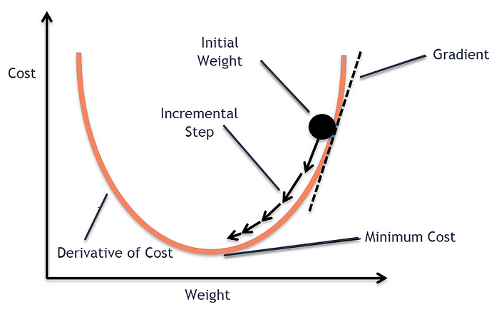
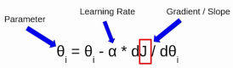
Gradient Descent and Its Variants
In a Neural Network, the Gradient Descent Algorithm is used during the backward propagation to update the parameters of the model.
Gradient descent is a first-order iterative optimization algorithm for finding the minimum of a function
The goal of the gradient descent is to minimize a given function which, in our case, is the loss function of the neural network. To achieve this goal, it performs two steps iteratively.
Compute the slope (gradient) that is the first-order derivative of the function at the current point.
Move-in the opposite direction of the slope increase from the current point by the computed amount.
J here represents the cost function

Slide 14
1. Batch Gradient Descent
In Batch Gradient Descent, all the training data is taken into consideration to take a single step.
We take the average of the gradients of all the training examples and then use that mean gradient to update our parameters. So that’s just one step of gradient descent in one epoch.
Parameter update equation
Algorithm
need to calculate the gradients for the whole dataset to perform just one update
Parameters are updated in the direction of gradient
Learning rate determines how big of an update we perform
Disadvantages
Very slow
Intractable for datasets that do not fit into the memory
Doesn’t allow the model to update online i.e., with new examples on the fly
Computations are redundant
for large datasets, as it recomputes gradients for similar examples before each parameter update

Slide 15
Stochastic Gradient Descent
Parameter update equation
Algorithm
Performs the parameter update for each training example
Parameters are updated in the direction of gradient
Learning rate determines how big of an update we perform
Advantages
Computations are NOT redundant like in batch gradient descent, thus faster
Can also be used for online learning
Disadvantages
SGD performs frequent updates with a high variance that cause the objective function to fluctuate heavily
But can be useful: enables it to jump to new and potentially better local minima
Note
We have to shuffle the training data at every epoch

Slide 16
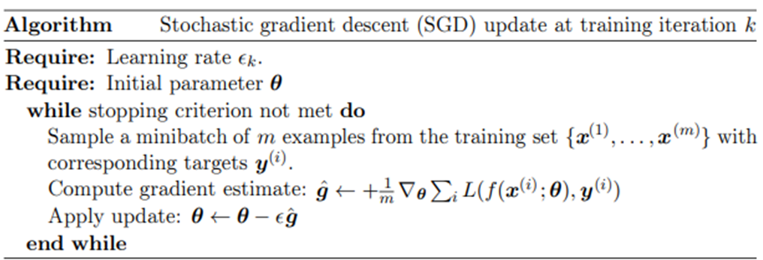

Slide 17
Mini Batch Gradient Descent
Parameter update equation
The objective function decomposes as a Sum over the training examples
Redundancy in the Training set
Common Batch Sizes range between 50 and 256.
Algorithm
Performs the parameter update for each batch of training example
Parameters are updated in the direction of gradient
Learning rate determines how big of an update we perform
Advantages
Reduces the variance of the parameter updates, which can lead to more stable convergence
Can make use of highly optimized matrix optimizations common to state-of-the-art deep learning libraries
Computing the gradient w.r.t. a mini-batch very efficient

Slide 18
Batch size
Larger or smaller which is better?
Examples of the batch are typically processed in parallel using multi-core architectures which get under-utilized by small size batches
For many hardware setups, the limiting factor is most often the memory to store the batch
If using GPUs, it is common for power of 2 batch sizes to offer better runtime (ranging from 32 to 256, 16 for large models)
In terms Hardware utilization
In terms better estimation of gradients
Larger batches provide a more accurate estimation for the gradient, but with less than linear returns
Small batches can offer a regularization effect
At the cost of a small learning rate to maintain stability
And a large total training runtime
It is also very important to shuffle the data

Slide 19
Comparison between Batch GD, SGD, and Mini-batch GD:
Number of observations used for Updation
In batch gradient Descent, as we have seen earlier as well, we take the entire dataset > calculate the cost function > update parameter.
In the case of Stochastic Gradient Descent, we update the parameters after every single observation and we know that every time the weights are updated it is known as an iteration.
In the case of Mini-batch Gradient Descent, we take a subset of data and update the parameters based on every subset.

Slide 20
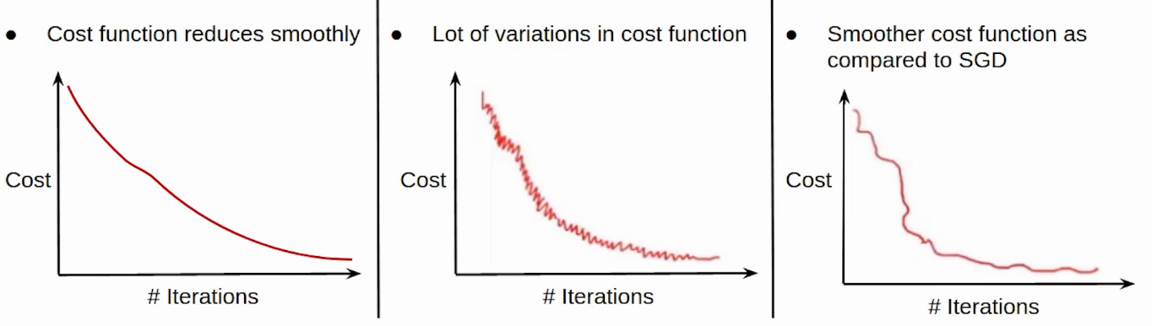
2. Cost function
Since we update the parameters using the entire data set in the case of the Batch GD, the cost function, in this case, reduces smoothly.
The updation in the case of SGD is not that smooth. Since we’re updating the parameters based on a single observation, there are a lot of iterations. It might also be possible that the model starts learning noise as well.
The Updation of the cost function in the case of Mini-batch Gradient Descent is smoother as compared to that of the cost function in SGD. Since we’re not updating the parameters after every single observation but after every subset of the data.

Slide 21
3. Computation Cost and Time
Since we’ve to load the entire data set at a time, perform the forward propagation on that and calculate the error and then update the parameters, the computation cost in the case of Batch gradient descent is very high.
Computation cost in the case of SGD is less as compared to the Batch Gradient Descent since we’ve to load every single observation at a time but the Computation time here increases as there will be more number of updates which will result in more number of iterations.
In the case of Mini-batch Gradient Descent, taking a subset of the data there are a lesser number of iterations or updations and hence the computation time in the case of mini-batch gradient descent is less than SGD. Also, since we’re not loading the entire dataset at a time whereas loading a subset of the data, the computation cost is also less as compared to the Batch gradient descent. This is the reason why people usually prefer using Mini-batch gradient descent. Practically whenever we say Stochastic Gradient Descent we generally refer to Mini-batch Gradient Descent.

Slide 22
Batch Gradient Descent | Stochastic Gradient Descent
Computes gradient using the whole Training sample | Computes gradient using a single Training sample
Slow and computationally expensive algorithm | Faster and less computationally expensive than Batch GD
Not suggested for huge training samples. | Can be used for large training samples.
Deterministic in nature. | Stochastic in nature.
Gives optimal solution given sufficient time to converge. | Gives good solution but not optimal.
No random shuffling of points are required. | The data sample should be in a random order, and this is why we want to shuffle the training set for every epoch.
Can’t escape shallow local minima easily. | SGD can escape shallow local minima more easily.

Slide 23
Batch Gradient Descent | Stochastic Gradient Descent
Convergence is slow. | Reaches the convergence much faster.
It updates the model parameters only after processing the entire training set. | It updates the parameters after each individual data point.
The learning rate is fixed and cannot be changed during training. | The learning rate can be adjusted dynamically.
It typically converges to the global minimum for convex loss functions. | It may converge to a local minimum or saddle point.
It may suffer from overfitting if the model is too complex for the dataset. | It can help reduce overfitting by updating the model parameters more frequently.

Slide 24
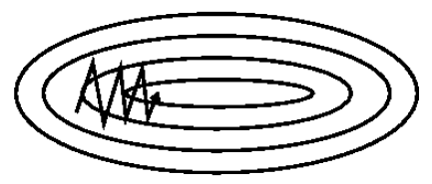
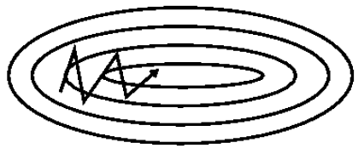
Momentum
Loss landscape | Ravines
Ravines: areas where the surface curves much more steeply in one dimension than in another
Ravines are common around local optima
High conditioning number of Hessian matrix is an indicator of ravines
How SGD without momentum deals the ravines
SGD has trouble navigating ravines
Oscillates across the slopes of the ravine
Hesitant progress along the bottom towards the local optimum
How SGD with momentum deals the ravines
Momentum:
It is a method that helps accelerate SGD in the relevant direction and dampens Oscillations
So it solves two problems:
Poor conditioning (i.e. ravines) of the Hessian matrix
High variance (i.e. oscillations) in SGD
SGD without Momentum
SGD with Momentum

Slide 25
Optimization for Training Deep Models |
Momentum
SGD
with out
Momentum
SGD without Momentum
From
Physics
Momentum = mass x velocity
Assume: mass = 1
The two
Forces
One Force is:
SGD with Momentum
Another is:
SGD
with
momentum
Update vector of the past time stamp
Update vector of current time stamp
The momentum term [0,1) usually set to 0.9

Slide 26
The other way, which is most popular way to write momentum update rules, is less intuitive and just omits (1 - beta) term.
This is pretty much identical to the first pair of equation, the only difference is that you need to scale learning rate by (1 - beta) factor.

Slide 27
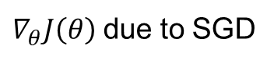
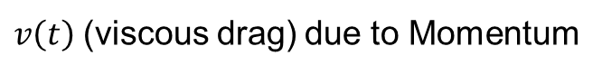
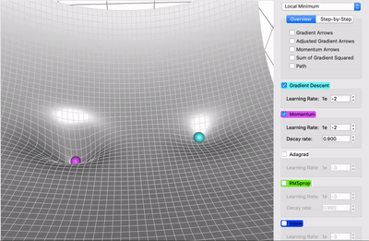
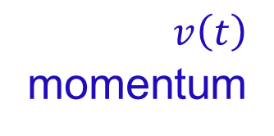
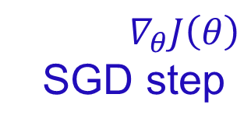
Optimization for Training Deep Models |
Momentum
Intuition
behind
momentum
There are
two forces
acting
$$∇_{θ}J\left(θ\right)$$
SGD step
The black arrows at each step indicates the path SGD would take at that point
Gradient steps waste time moving back and forth across the narrow axis of the loss contour
Quadratic loss function with a
poorly conditioned Hessian matrix
$v\left(t\right)$
momentum
The red path cutting across the loss contours indicates the path followed by momentum learning rule as it minimizes the cost function
Momentum correctly traverses loss contours lengthwise
As a result, momentum learning rule enables SGD to skip or cross the local minima

Slide 28
Optimization for Training Deep Models |
Nesterov Accelerated Gradient (NAG)
SGD
with
momentum
What momentum does is…
Usually SGD updates the parameter vector in the direction specified by the gradient of the cost function i.e.,
It doesn’t take into consideration from which direction it has arrived at that location while doing that update
Momentum considers that previous update direction along with the direction specified by the gradient
SGD
with
Nesterov
Now Nesterov considers the gradients with respect to the approximate future positions of the parameters also
This means that… if we update the parameters with momentum, from that updated position in which direction cost decreases is also considered in updating the parameters at the current position
but how?
Parameter update equation

Slide 29
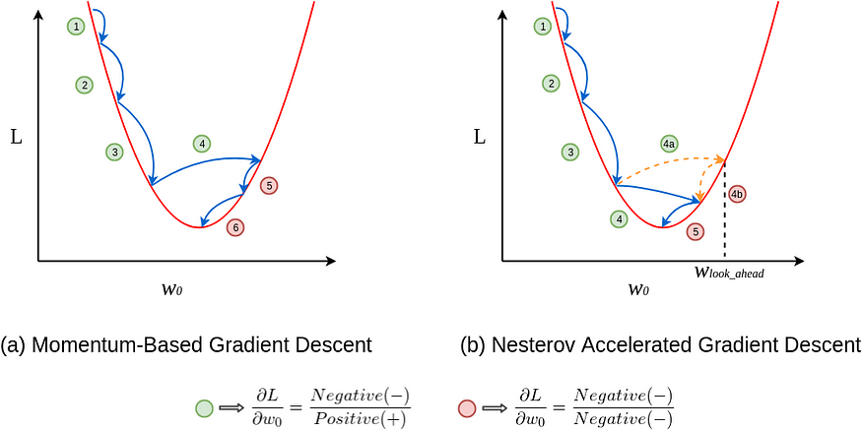
Optimization for Training Deep Models |
Nesterov Accelerated Gradient
Parameter update equation

Slide 30
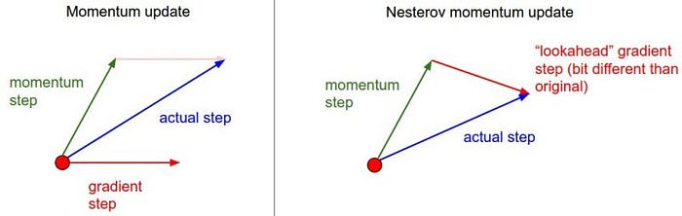
Optimization for Training Deep Models |
Nesterov Accelerated Gradient
Parameter update equation
In SGD with Nesterov accelerated gradient, we first look at a point where current momentum is pointing to and computing gradients from that point.

Slide 31
First make a big jump in the direction of the previous accumulated gradient.
Then measure the gradient where you end up and make a correction.
brown vector = jump,
red vector = correction,
green vector = accumulated gradient
blue vectors = standard momentum

Slide 32
Optimization for Training Deep Models
Algorithms with adaptive learning rates
Adagrad | Adadelta | RMSprop | Adam

Slide 33
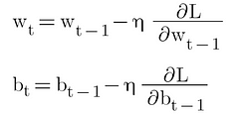
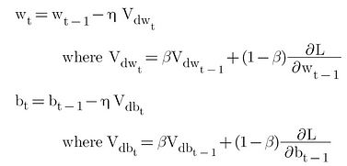
SGD without Momentum
w(t) = value of w at current iteration, w(t-1) = value of w at previous iteration and η = learning rate
SGD with Momentum
In SGD and mini-batch SGD, the value of η used to be the same for each weight, or say for each parameter. Typically, η = 0.01.

Slide 34
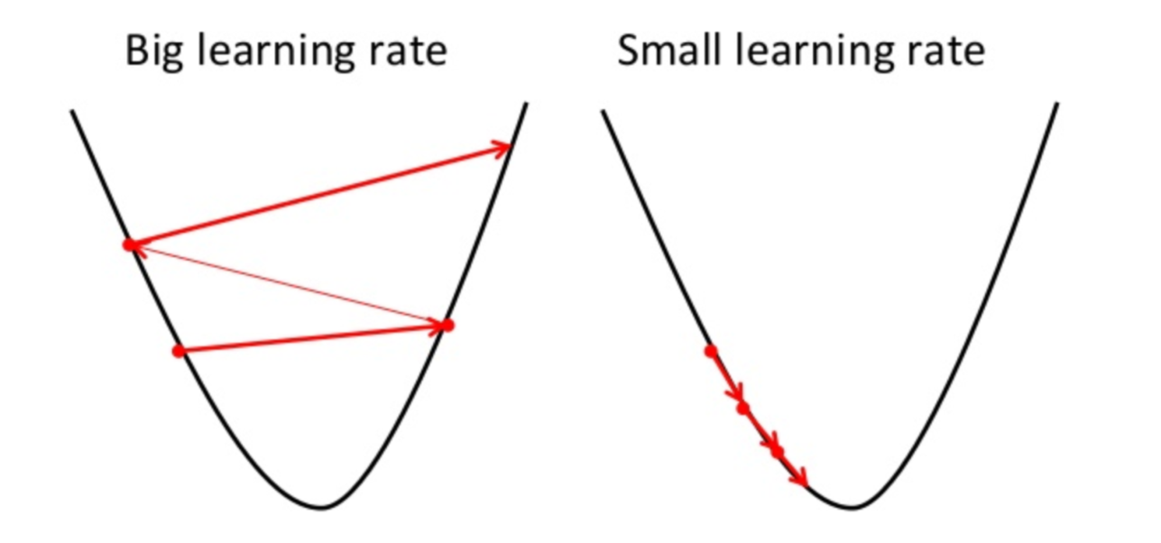

Learning Rate
Choosing a proper learning rate can be difficult.
A learning rate that is too small leads to painfully slow convergence, while a learning rate that is too large can hinder convergence and cause the loss function to fluctuate around the minimum or even to diverge.
Learning rate schedules try to adjust the learning rate during training by e.g. annealing, i.e. reducing the learning rate according to a pre-defined schedule or when the change in objective between epochs falls below a threshold. These schedules and thresholds, however, have to be defined in advance and are thus unable to adapt to a dataset’s characteristics.
Additionally, the same learning rate applies to all parameter updates. If our data is sparse and our features have very different frequencies, we might not want to update all of them to the same extent, but perform a larger update for rarely occurring features.
There is no generic right value for learning rate. It comes down to experimentation and intuition.

Slide 35
Adagrad Optimizer
Adagrad stands for Adaptive Gradient Optimizer
In Adagrad Optimizer the core idea is that each weight has a different learning rate (η).
This modification has great importance, in the real-world dataset, some features are sparse and some are dense , so keeping the same value of learning rate for all the weights is not good for optimization.
Adagrad Optimizer adapts the learning rate to the parameters, performing larger updates for infrequent and smaller updates for frequent parameters.
Adagrad greatly improved the robustness of SGD and used it for training large-scale neural nets.
Where alpha(t) denotes Summation of Gradient Square.
Here, η is a constant number, epsilon is a small positive value number to avoid divide by zero error if in case alpha(t) becomes 0 because if alpha(t) become zero then the learning rate will become zero which in turn after multiplying by derivative will make w(old) = w(new), and this will lead to small convergence.

Slide 36
As alpha(t) and is inversely proportional to one another, this implies that as alpha(t) will increase, will decrease. This means that as the number of iterations will increase, the learning rate will reduce adaptively, so you no need to manually select the learning rate.
Advantages of Adagrad:
No manual tuning of the learning rate required.
Faster convergence
More reliable
One main disadvantage of Adagrad optimizer is that alpha(t) can become large as the number of iterations will increase and due to this will decrease at the larger rate. This will make the old weight almost equal to the new weight which may lead to slow convergence.

Slide 37
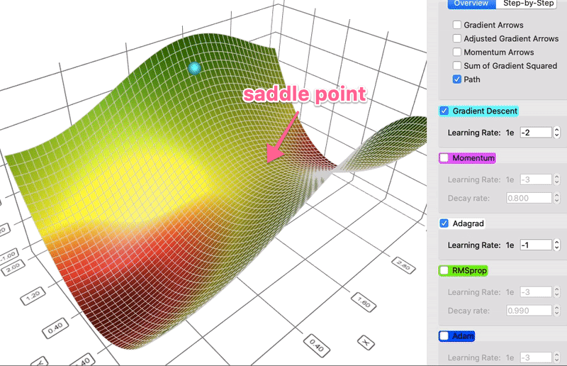
The parameters with the largest partial derivative of the loss have a correspondingly rapid decrease in their learning rate
Parameters with small partial derivatives have a relatively small decrease in their learning rate.
The net effect is greater progress in the more gently sloped directions of parameter space.
AdaGrad performs well for some but not all deep learning models.

Slide 38
Adadelta Optimizer
Adadelta is an extension of Adagrad that seeks to reduce its aggressive, monotonically decreasing learning rate.
Instead of accumulating all past squared gradients, Adadelta restricts the window of accumulated past gradients to some fixed size w.
Instead of inefficiently storing w previous squared gradients, the sum of gradients is recursively defined as a decaying average of all past squared gradients.
The above equation shows that as the time steps “t” increase the summation of squared gradients “α” increases which led to a decrease in learning rate “η”. In order to resolve the exponential increase in the summation of squared gradients “α”, we replaced the “α” with exponentially weighted averages of squared gradients.
https://paperswithcode.com/method/adadelta

Slide 39
So, here unlike the alpha “α” in Adagrad, where it increases exponentially after every time step, in Adadelta, using the exponentially weighted averages over the past Gradient, an increase in “S_{t}” is under control.
The typical “β” value is 0.9 or 0.95.

Slide 40
RMSProp
The RMSProp algorithm (Hinton, 2012) modifies AdaGrad to perform better in the non-convex setting by changing the gradient accumulation into an exponentially weighted moving average.
RMSProp is currently one of the go-to optimization methods being employed routinely by deep learning practitioners
The RMSprop optimizer is similar to the gradient descent algorithm with momentum.
The RMSprop optimizer restricts the oscillations in the vertical direction. Therefore, we can increase our learning rate and our algorithm could take larger steps in the horizontal direction converging faster.
The difference between RMSprop and gradient descent is on how the gradients are calculated.

Slide 41
Where
is the moving average of squared gradients,
is gradient of the cost function with respect to the weight,
is the learning rate and
is moving average parameter (default value — 0.9, to make the sum of default gradient value 0.1 on nine mini-batches and -0.9 on tenths is approximate zero, and the default value is 0.001 as per experience).

Slide 42
Adam Optimizer
Adaptive Moment Estimation
Combination of the ‘gradient descent with momentum’ algorithm and the ‘RMSProp’ algorithm.
SGD with momentum
RMSProp
v_{t} = aggregate of gradients at time t [current] (initially, v_{t} = 0)
v_{t-1} = aggregate of gradients at time t-1 [previous]
ω_{t} = weights at time t
ω_{t+1} = weights at time t+1
η = learning rate at time t
∂J = derivative of Loss Function
∂ω_{t} = derivative of weights at time t
β = Moving average parameter (const, 0.9)
v_{t} = sum of square of past gradients at time t [current] (initially, v_{t} = 0)
ω_{t} = weights at time t
ω_{t+1} = weights at time t+1
η = learning rate at time t
∂J = derivative of Loss Function
∂ω_{t} = derivative of weights at time t
β = Moving average parameter (const, 0.9)

Slide 43
β₁ & β₂ = decay rates of average of gradients in the above two methods. (β₁ = 0.9 & β₂ = 0.999)
Intuitively, we are adapting to the gradient descent after every iteration so that it remains controlled and unbiased throughout the process, hence the name Adam.
Now, instead of our normal weight parameters v_{t} and E[g](t) , we take the bias-corrected weight parameters (v_{t} hat)_{t} and (E[g](t))_{t}. Putting them into our general equation, we get

Slide 44
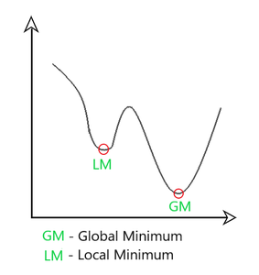
Adam Optimizer inherits the strengths or the positive attributes of the above two methods and builds upon them to give a more optimized gradient descent.
We control the rate of gradient descent in such a way that there is minimum oscillation when it reaches the global minimum while taking big enough steps (step-size) so as to pass the local minima hurdles along the way. Hence, combining the features of the above methods to reach the global minimum efficiently.

Slide 45
The name “Adam” derives from the phrase “adaptive moments.”
In Adam, momentum is incorporated directly as an estimate of the first order moment (with exponential weighting) of the gradient
Adam includes bias corrections to the estimates of both the first-order moments (the momentum term) and the (uncentered) second-order moments to account for their initialization at the origin.
RMSProp also incorporates an estimate of the (uncentered) second-order moment, however it lacks the correction factor.
Thus, unlike in Adam, the RMSProp second-order moment estimate may have high bias early in training.
Adam is generally regarded as being fairly robust to the choice of hyperparameters, though the learning rate sometimes needs to be changed from the suggested default.

Slide 46
Optimization for Training Deep Models |
Choosing the Right Optimization Algorithm
Currently, the most popular optimization algorithms actively in use include SGD, SGD with momentum, RMSProp, RMSProp with momentum, Adam, and AdaDelta.
The choice depends largely on the user’s familiarity with the algorithm (for ease of hyperparameter tuning)

